Slide 1
WRECKS Wireless Roadside Emergency Collision Kinetic Sensor
Notes:
AJ

Slide 2
MEET THE TEAM
Ajaya Dahal
Banepa, Nepal
Computer Engineering Team Lead
Software Communication Lead
Zachary Sahnger
Hernando, MS
Computer Engineering Software Functionality Lead
Joey Westerfield
Mobile, AL
Electrical Engineering Power Distribution Lead
Walker Thames
Buford, GA
Electrical Engineering Hardware Communication Lead
Will Clark
Madison, MS
Electrical Engineering Sensor Lead
Notes:
AJ

Slide 3
TEAM ADVISOR
Dr. Ryan Green
Electrical and Computer Engineering
Academic Research/Fields of Interest
Smart-City Communication
Internet of Things
Optically Transparent Communication Devices
Wireless Medical Telemetry
Notes:
Will

Slide 4
External ADVISOR
Neal Wise
CFO Atwood Fence Company
BBA, Mississippi State University, 2008
JD, University of Mississippi Law, 2011
Notes:
Will

Slide 5
OUTLINE
Problem
Solution
Constraints
Approach
Timeline
Notes:
Joey

Slide 6
Problem
Terminal end sections (TES) are everywhere
TES are constantly being destroyed and replaced
Too many resources spent on monitoring and replacing
[1]
Notes:
Walker

Slide 7
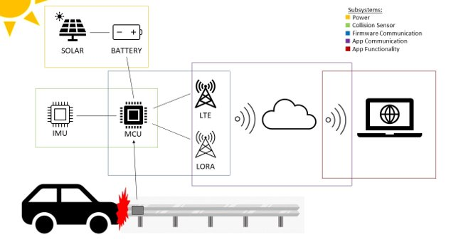
SOLUTION
Remote sensor to monitor guardrail status
Collect crash data
Send real-time notifications to customers
Notes:
Zack

Slide 8
DESIGN CONSTRAINTS
Notes:
AJ

Slide 9
TECHNICAL CONSTRAINTS
Name | Description
Battery Life | The battery lasts two weeks without charging.
GPS Data | WRECKS uses a GPS that is accurate within 8 meters.
Sensor Data | The IMU sensor has a margin of error of 1%.
Sampling Rate | The device samples IMU data at 50 Hz.
Communication | WRECKS alerts customers to damaged safety assets via web/Android applications, email, and MMS messaging.
Latency | Notifications from WRECKS reach the customer no later than thirty seconds after a crash occurs.
Notes:
AJ(Battery to sensor) and Walker(Sampling to latency)

Slide 10
PRACTICAL CONSTRAINTS
Type | Name | Description
Safety | Notifications | The device can contact emergency services in the case of a crash.
Environmental | Waterproofing | The device survives storms and flooding.
Environmental | Temperature | The device functions in both hot and cold severe weather conditions.
Economic | Price | The device is priced less than one hundred dollars.
Sustainability | Lifespan | The device is designed to last five years.
Manufacturability | Attachment | WRECKS is attached to the guardrail using adhesive pads.
Manufacturability | Size | The entire device is no larger than 100 mm wide, 100 mm long, and 50 mm tall.
Notes:
Joey(safety to enviornmental) and Zachary(Economic to manufacturability)

Slide 11
ENGINEERING STANDARDS
Specific standard | Standard document | Specification / application
IP Rating | IP-67 [2] | WRECKS meets the specifications for an IP-67 rating.
Communication | FCC 01-158 [3] | WRECKS uses the LoRa protocol, which utilizes the 915 MHz ISM band.
Communication | IEEE Std 802.16m [4] | WRECKS also uses the 4G/LTE network for the communication.
Global Positioning System | IEEE 2030.101-2018 [5] | WRECKS app utilizes GPS technology to pinpoint the detected collision.
Notes:
Will

Slide 12
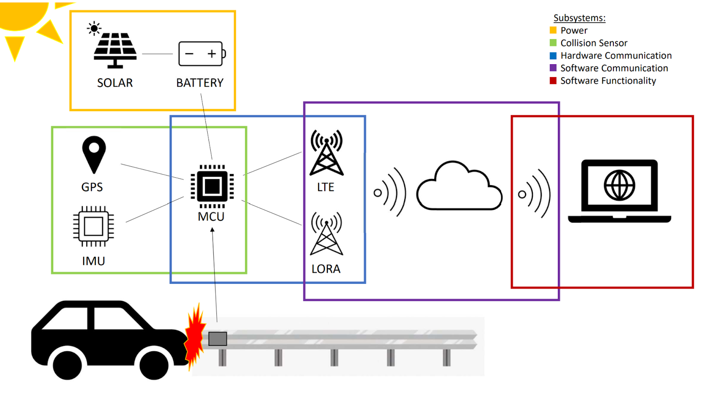
APPROACH
Notes:
Walker

Slide 13
SUBSYSTEMs
Hardware
Communication
SOFTWARE
Communication
Sensors
Software
Functionality
Power Distribution
Notes:
Walker

Slide 14
HARDWARE
Battery
Battery Charging Circuit
Solar Panel
LoRa Module
Cellular Module
Antenna
GPS Module
Inertial Measurement Unit
Microcontroller
Notes:
Zack

Slide 15
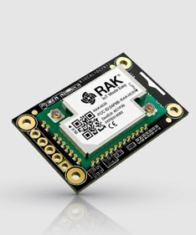
microcontroller
Brain of the device
Communicates data via cellular and LoRa modules
Receives and interprets data from the IMU
[6]​​
Notes:
AJ

Slide 16
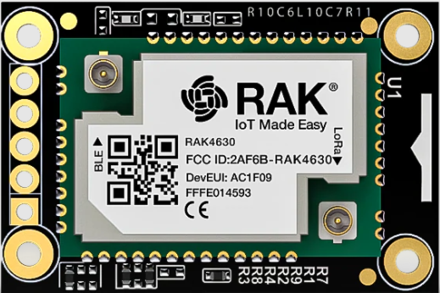
microcontroller COMPARISON
Product | Clock Speed (Hz) | Input/Output | Dimensions (mm) | Cost (USD)
Requirements | 60 MHz | Pigtail, battery, and solar connectors | 60 x 60 | $60.00
RAK5005-O + RAK4631 [6],[7] | 64 MHz | 2x pigtail for BLE and LoRa, Battery and Solar connectors, UART, I2C, GPIO, USB | 30 x 60 | $27.99
Arduino RP2040 Connect [8] | 133MHz | 14x Digital Pin, 8x Analog Pin, Micro USB, UART, SPI, I2C | 18 x 45 | $27.25
Particle Boron LTE [9] | 64MHz | 20 pin GPIO (6 Analog, 8 PWM, I2C, SPI, UART) | 23 x 50 | $59.37
Raspberry Pi Zero [10] | 1GHz | 40 pin GPIO | 30 x 65 | $5.00
[6],[7]​
RAK5005-O + RAK 4631
Excellent dimensions
Comes with LoRa and Bluetooth modules
Complete with built-in charging circuit and direct connections to solar and battery
Notes:
AJ

Slide 17
LORA MODULE
Enables LoRaWAN radio connectivity for WRECKS
Used in conjunction with 4G to cover a wider service area
Send detected crash data to web/mobile app
[6]
Notes:
Zack

Slide 18
LORA MODULE COMPARISON
Product | Input Voltage (V) | Maximum Current | Dimensions (mm) | US Band | Cost (USD)
Requirements | 3.3 | 150 | 30 x 30 | YES | $20.00
REYAX RYLR896 Lora Module SX1276 [11] | 3.3 | 43 mA | 21.5 x 22.75 | YES | $19.50
Gowoops SX1276 LoRa Radio Wireless [12] | 3.3 or 5 | 120 mA | 21 x 36 | YES | $21.99
RakWireless RAK4631 [6] | 3.3 | 125 mA | 20 x 30 | YES | $17.99
Seeeduino LoRaWAN [13] | 3.3 | 200 mA | 23 x 28 | YES | $39.99
[6]​
RAK4631
Combines MCU and LoRaWAN modules, very cost effective
Ultra-low power consumption
Notes:
Zack

Slide 19
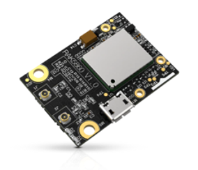
CELLULAR MODULE
Adds cellular connectivity to WRECKS as an alternative to LoRaWAN to cover more areas
Sends crash data to web/mobile app
[14]​
Notes:
Walker

Slide 20
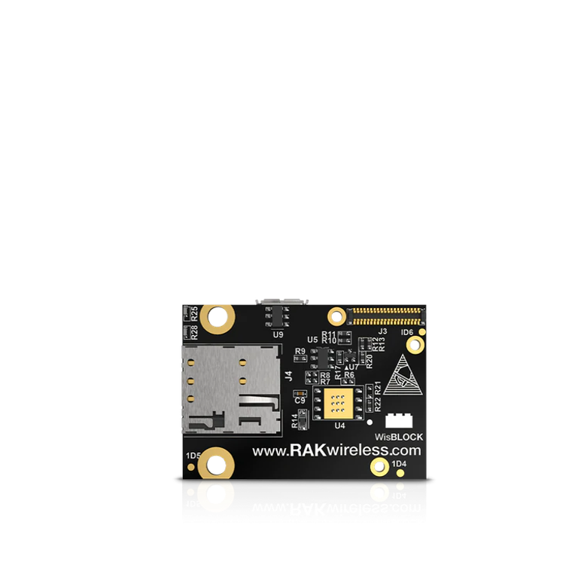
CELLULAR MODULE COMPARISON
Product | Input Voltage (V) | Dimensions (mm) | 4G/LTE | Cost (USD)
Requirements | 3.3 - 4.2 | 40 x 40 | YES | $35.00
HiLetgo Smallest SIM800L [15] | 3.5 - 4.2 | 25 x 23 | NO | $8.99
SIM7080G with LTE GPS External Antenna [16] | 5 | 30.2 x 65 | YES | $42.99
NB IoT 5 Click [17] | 3.3 or 5 | 57.2 x 25.4 | YES | $49.99
RAK5860 [14] | 4.2 | 35 x 25 | YES | $30.00
[14]​
RAK5860​
Combines GPS/GNSS and Cellular Module
CAT M1 and NB-IoT Capable
Notes:
Walker

Slide 21
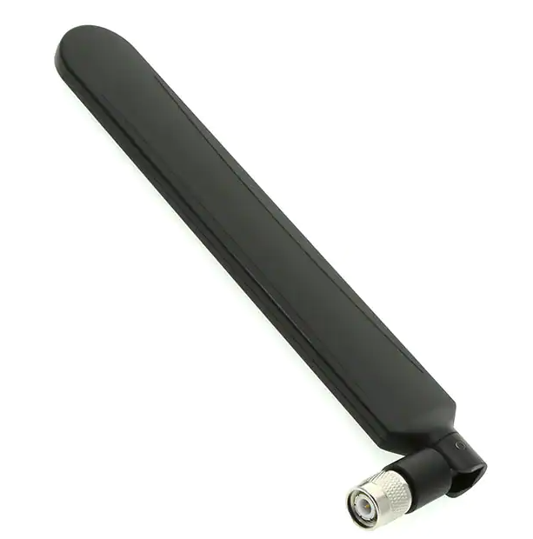
ANTENNA
Allows effective access to 4G/LTE and LoRa services
Gives a wider band of connectivity than proprietary antennas
[18]​
Notes:
Will

Slide 22
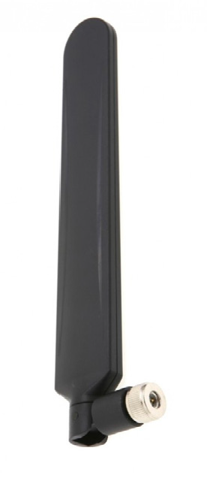
ANTENNA COMPARISON
Product | Frequency Range (Hz) | Gain (dB) | Connector | Cost (USD)
Requirements | 617 MHz ~ 960 MHz, 1.43 GHz ~ 3.5 GHz, | 5 dBi | SMA Male | $15.00
PulseLarson W1096X [19] | 698MHz ~ 960MHz, 1.71GHz ~ 2.69GHz, 3.4GHz ~ 3.8GHz | -3dBi, 1.5dBi, -0.5dBi | RP SMA Male | $11.72
PulseLarson W5150 [18] | 617MHz ~ 960MHz, 1.43GHz ~ 3.5GHz, 3.5GHz ~ 6GHz | 1.2dBi, 2.5dBi, 5.5dBi | SMA Male | $14.34
PulseLarson W3907B0127 [20] | 698MHz ~ 960MHz, 1.4279GHz ~ 1.5109GHz, 1.559GHz ~ 1.61GHz, 1.695GHz ~ 2.2GHz, 2.3GHz ~ 2.7GHz, 3.4GHz ~ 3.6GHz | 2.9dBi, 1.7dBi, 1.8dBi, 3.4dBi, 3.8dBi, 4.2dBi | IPEX MHF | $4.58
Bingfu 4G LTE Antenna 9dBi SMA Male Cellular Antenna [21] | 698-960 MHz, 1710-2170 MHz, 2300-2700 MHz | 9dBi | SMA Male | $6.99
[18]​
PulseLarson W5150
Wide frequency coverage
Compatible with LoRa and LTE
Notes:
Will

Slide 23
GPS MODULE
Provides longitude and latitude of the location where collision occurred
Retrieves the coordinates during initial setup
[14]​
Notes:
Joey

Slide 24
GPS MODULE COMPARISON
Product | Accuracy (m) | Update Rate (Hz) | Dimensions (mm) | Cost (USD)
Requirements | 2 | 10 | 40 x 40 x10 | $30.00
DFRobot TEL0137 USB GPS Receiver [22] | 2.5 m | 1 Hz | 60 x 24 x 9 | $9.70
RAK5860 [14] | 2 m | 10 Hz | 25 x 35 | $30.00
XA1110_1103891 [23] | 3 m | 1 - 10 Hz | 12.5 x 12.5 x 6.8 | $19.87
MC60CA-04-STD [24] | 2.5 m | NA | 18.7 x 16 x 2.1 | $21.61
[14]​
RAK5860
Comes with GPS and Cellular Module
Update rate is 10 Hz with 25 x 35 mm
Notes:
Joey

Slide 25
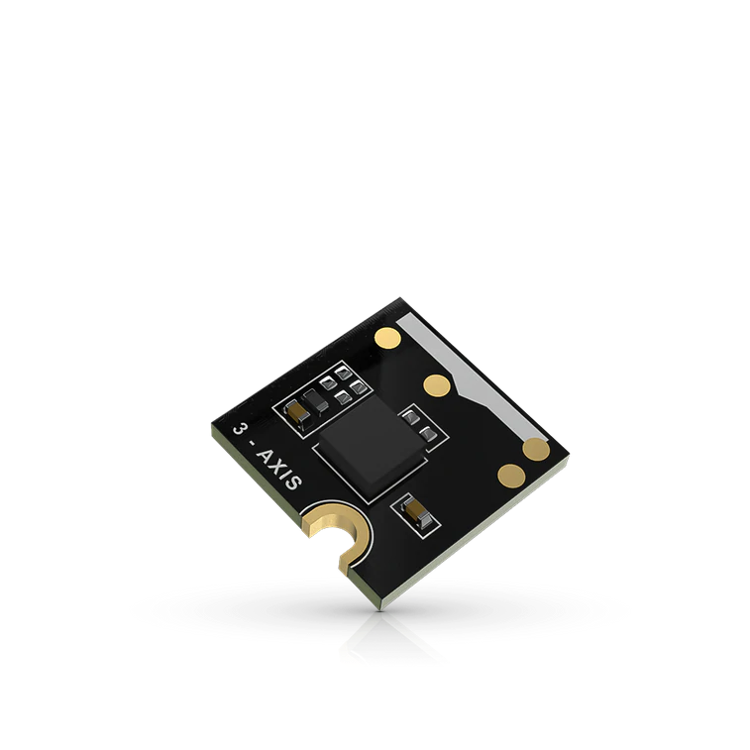
INERTIAL MEASUREMENT UNIT
Uses accelerometer, magnetometer and gyroscope to detect the collision
WRECKS requires high sampling rate IMU
[25]​
Notes:
Walker

Slide 26
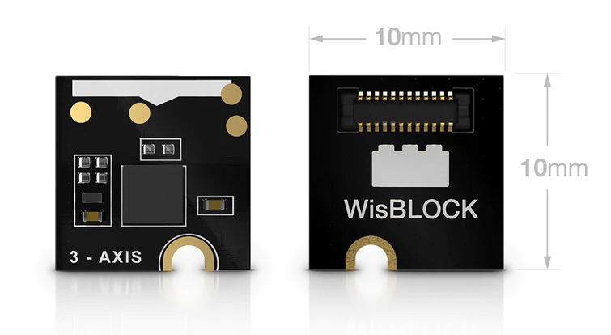
INERTIAL MEASUREMENT UNIT COMPARISON
Product | Sensor Type | Acceleration (g) | Communication Protocol | Dimensions (mm) | Cost (USD)
Requirements | 3-axis | 2 -16 | I2C or SPI | 15 x 15 | $10.00
OpenIMU330BI [26] | 6-axis | 8g | SPI, UART | 11 x 15 | $114.79
MTi-1-0I-T [27] | 9-axis | 16g | I2C, SPI, UART | 12 x 12 | $149.00
MPU-6881 [28] | 6-axis | 2g/4g/8g/16g | I2C, SPI | 3 x 3 | $11.77
RAK1904 [25] | 3-axis | 2g/4g/8g/16g | I2C, SPI | 10 x 10 | $3.30
SCC2230-E02-05 [29] | 3-axis | 2g | SPI | 12 x 15 | $86.79
[25]​
RAK1904
Price effective
Works with RAK ecosystem
Notes:
Walker

Slide 27
SOLAR PANEL
Needs to provide sufficient power
Uses the sun to charge battery
Needs to fit on the enclosure
[30]
Notes:
AJ

Slide 28
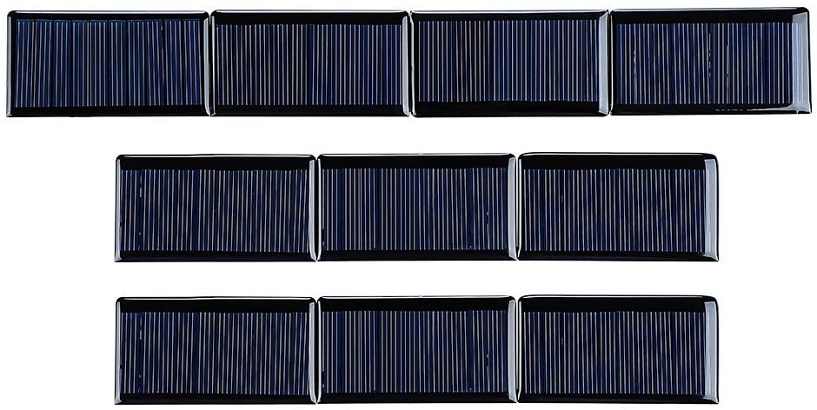
SOLAR PANEL COMPARISON
Product | Output Voltage (Volts DC) | Output Current (mA) | Dimensions (mm) | Cost (USD)
Requirements | 5 | 30 | 70 x 70 | $5.00
SUNYIMA [30] | 5 | 60 | 68 x 37 | $1.60
AOSHIKE [31] | 5 | 30 | 53 x 30 | $1.60
Panasonic AM-5907CAR-DGK-T [32] | 5 | 45.7 | 75 x 55 x 2 | $14.36
[30]
SUNYIMA
Meets voltage requirement
Low cost
Small formfactor
Notes:
AJ

Slide 29
BATTERY
Powers the system
Needs to be higher voltage than required to be regulated
Needs enough charge to last two weeks
[33]
Notes:
Joey

Slide 30
BATTERY COMPARISON
Product | Output Voltage (Volts DC) | Capacity (mAh) | Dimensions (mm) | Cost (USD)
Requirements | 3.7 | 2500 | 80 x 80 x 10 | $12.00
Liter 406080 Lipo [33] | 3.7 | 3000 | 80 x 60 x 4 | $10.99
VIDAR Lithium-ion [34] | 3.7 | 4400 | 68 x 37 x 19 | $24.99
Liter 104050 Lipo [35] | 3.7 | 2400 | 50 x 40 x 10 | $10.99
Liter 123464 Lipo [36] | 3.7 | 2800 | 64 x 34 x 12 | $11.99
[33]
Liter 406080
​ Dimensions fit best with system
Highest capacity per dollar
Voltage higher than 3.3V
​
Notes:
Joey

Slide 31
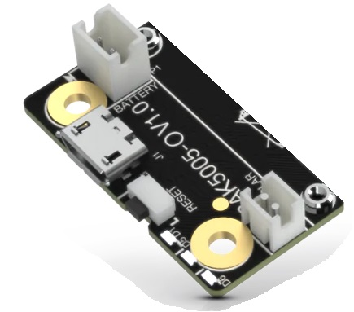
BATTERY Charging circuit
Regulates battery charging
Power from solar panel
[7]
Notes:
Will

Slide 32
BATTERY CHARGING CIRCUIT COMPARISON
Product | Input Voltage (Volts DC) | Output Voltage (Volts DC) | Dimensions (mm) | Cost (USD)
Requirements | 5.0 | 3.7 | 60 x 60 | $10.00
RakWireless RAK5005-O [7] | 4.5 - 5.5 | 3.3 - 4.3 | 30 x 60 | $9.99
MAX2074ATDA [37] | 3 - 5.5 | 6 - 18 | 3 x 3.5 | $2.50
XL6009 [38] | 3.8 - 32 | 1.25 - 35 | 48 x 24 | $2.80
[7]
RakWireless RAK5005-O
Comes built into baseboard
Ease of connectivity between solar panel and battery
Notes:
Will

Slide 33
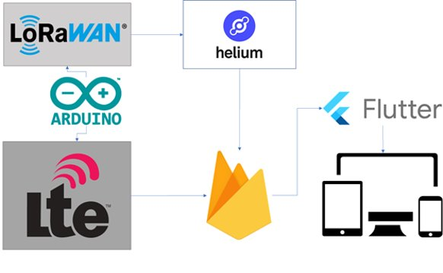
SOFTWARE
[39]-[43]
Notes:
Zack

Slide 34
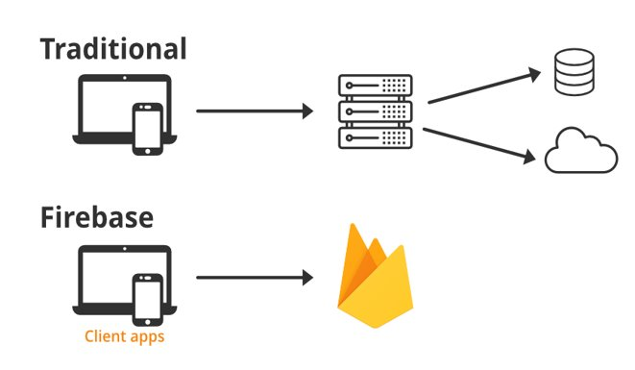
CONNECTIVITY & INTEGRATION
LTE
LoRa
[39]
Notes:
AJ

Slide 35
Project timeline
PHASE 1
1
Formed team
Interacted with customer
Brainstorm
Pitch
PHASE 2
2
February
Design constraints
PHASE 3
3
PHASE 4
4
Researched Parts
Received parts from customer
March
Approach
Coding
Assemble hardware
Evaluation
Testing
Presentation
April
January
Notes:
Will

Slide 36
Conclusion
Problem from our sponsor
WRECKS is an IoT solution to the problem
Detect collision in the guardrails and send real-time notifications
Design Constraints discussed the design requirements
Approach is based on the constraints with study of available components
Moving Forward
Notes:
Walker

Slide 37
Thank you

Slide 38
Questions

Slide 39
references
[1] Go.com, 2022. Available: https://cdns.abclocal.go.com/content/kgo/images/cms/1502726_1280x720.jpg (Accessed Jan. 26, 2022).
[2] “IP rating - Enviromed.” [Online]. Available: http://enviromed.ca/documents/IP%20Rating%20Chart.pdf. [Accessed: 24-Feb-2022].
[3] “Federal Communications Commission.” Accessed: Apr. 05, 2022. [Online]. Available: https://transition.fcc.gov/Bureaus/Engineering_Technology/Notices/2001/fcc01158.pdf
[4] IEEE 802.16m System Requirements. Institute for Electronics and Electrical Engineers, 2008. [Online]. Available: https://ieee802.org/16/tgm/docs/80216m-07_002r7.pdf [Accessed 24-Feb-2022].
[5] “IEEE Guide for Designing a Time Synchronization System for Power Substations,” IEEE 2030.101-2018, pp. 1–118, Jul. 2018, doi: 10.1109/IEEESTD.2018.8421294.
[6] “RAK4631 | nRF52840 SX1262 | Module for LoRaWAN,” RakWireless.com, 2022. [Online]. Available: https://store.rakwireless.com/products/rak4631-lpwan-node (Accessed Mar. 08, 2022).
[7] “RAK5005-O | WisBlock Base Board,” RakWireless.com, 2022. [Online]. Available: https://store.rakwireless.com/products/rak5005-o-base-board (Accessed Mar. 08, 2022).
[8] “Nano RP2040 Connect | Arduino Documentation,” Arduino.cc, 2022. [Online]. Available: https://docs.arduino.cc/hardware/nano-rp2040-connect (Accessed Mar. 08, 2022).

Slide 40
References Cont.
[9] “Boron LTE CAT-M1 (NorAm),” Particle.io, 2022. [Online]. Available: https://store.particle.io/products/boron-lte (Accessed Mar. 08, 2022).
[10] “Buy a Raspberry Pi Zero,” Raspberrypi.com, 2022. [Online]. Available: https://www.raspberrypi.com/products/raspberry-pi-zero/ (Accessed Mar. 08, 2022).
[11] “REYAX RYLR896 Lora Module SX1276 UART 868MHz 915MHz Antenna,” Amazon.com, 2022. [Online]. Available: https://www.amazon.com/RYLR896-Module-SX1276-Antenna-Command/dp/B07NB3BK5H (Accessed Mar. 08, 2022).
[12] “Gowoops SX1276 LoRa Radio Wireless 915Mhz UART Serial Module LoRaWAN Transmitter Receiver,” Amazon.com, 2022. [Online]. Available: https://www.amazon.com/Gowoops-Wireless-Transmitter-Compatible-Microcomputer/dp/B07G7RZLTW/ref=pd_sbs_5/141-3004043-4104327?pd_rd_w=Ol66E&pf_rd_p=dfec2022-428d-4b18-a6d4-8f791333a139&pf_rd_r=1SHQPNNKQK2XQV085V2D&pd_rd_r=30139669-015c-4587-bdaa-c8dd41c81e04&pd_rd_wg=ySFCY&pd_rd_i=B07G7RZLTW&psc=1 (Accessed Mar. 08, 2022).
[13] “Seeed Studio 102010128,” Mouser.com, 2022. [Online]. Available: https://www.mouser.com/ProductDetail/Seeed-Studio/102010128?qs=WY0B%252Bpw29jMGjDlFmQEYGA%3D%3D (Accessed Mar. 08, 2022).
[14] “RAK5860 | BG77 | NB-IoT Interface Module,” RakWireless.com, 2022. [Online]. Available: https://store.rakwireless.com/products/rak5860-lte-nb-iot-extension-board (Accessed Mar. 08, 2022).

Slide 41
References Cont.
[15] “HiLetgo Smallest SIM800L GPRS GSM Breakout Module,” Amazon.com, 2022. [Online]. Available: https://www.amazon.com/HiLetgo-Smallest-Breakout-Quad-band-3-7-4-2V/dp/B01DLIJM2E/ref=pd_lpo_2?pd_rd_i=B01DLIJM2E&psc=1 (Accessed Mar. 08, 2022).
[16] “NB-IoT Cat-M (eMTC) GNSS HAT Based on SIM7080G with LTE,” Amazon.com, 2022. [Online]. Available: https://www.amazon.com/Raspberry-SIM7080G-External-Interface-XYGStudy/dp/B08434FHLJ/ref=sr_1_7?crid=389MJCVFW41JF&keywords=nb-iot+LTE&qid=1646012159&s=electronics&sprefix=nb-iot+lte%2Celectronics%2C80&sr=1-7 (Accessed Mar. 08, 2022).
[17] “MIKROE-4472 MikroElektronika | Development Boards, Kits, Programmers,” Digikey.com, 2022. [Online]. Available: https://www.digikey.com/en/products/detail/mikroelektronika/MIKROE-4472/13958758 (Accessed Mar. 08, 2022).
[18] “W5150 PulseLarsen Antennas,” Digikey.com, 2022. [Online]. Available: https://www.digikey.com/en/products/detail/pulselarsen-antennas/W5150/13244581 (Accessed Mar. 08, 2022).
[19] “W1096 PulseLarsen Antennas,” Digikey.com, 2022. [Online]. Available: https://www.digikey.com/en/products/detail/pulselarsen-antennas/W1096/13244582 (Accessed Mar. 08, 2022).

Slide 42
References Cont.
[20] “W3907B0127 PulseLarsen Antennas,” Digikey.com, 2022. [Online]. Available: https://www.digikey.com/en/products/detail/pulselarsen-antennas/W3907B0127/15287060 (Accessed Mar. 08, 2022).
[21] “Bingfu 4G LTE Antenna 9dBi SMA Male Cellular Antenna Compatible with 4G LTE Wireless CPE Router Hotspot,” Amazon.com, 2022. [Online]. Available: https://www.amazon.com/Bingfu-Cellular-Wildlife-Security-Amplifier/dp/B08139ZVVF/ref=sr_1_8?crid=RW4KT6092DBO&keywords=4g%2Bantenna&qid=1646771762&sprefix=4g%2Bantenna%2Caps%2C135&sr=8-8&th=1 (Accessed Mar. 08, 2022).
[22] “TEL0137 DFRobot,” Mouser.com, 2022. [Online]. Available: https://www.mouser.com/ProductDetail/DFRobot/TEL0137?qs=DRkmTr78QAQBGHkfGqmsFw%3D%3D (Accessed Mar. 05, 2022).
[23] “XA1110_1103891 Sierra Wireless,” Digikey.com, 2022. [Online]. Available: https://www.digikey.com/en/products/detail/sierra-wireless/XA1110-1103891/8572914 (Accessed Mar. 05, 2022).
[24] “MC60CA-04-STD Quectel,” Digikey.com, 2022. [Online]. Available: https://www.digikey.com/en/products/detail/quectel/MC60CA-04-STD/13278076 (Accessed Mar. 05, 2022).
[25] “RAK1904 | LIS3DH | 3-axis acceleration sensor,” RakWireless.com, 2022. [Online]. Available: https://store.rakwireless.com/products/rak1904-lis3dh-3-axis-acceleration-sensor (Accessed Mar. 06, 2022).

Slide 43
References Cont.
[26] “OpenIMU330BI ACENNAr,” Mouser.com, 2022. [Online]. Available: https://www.mouser.com/ProductDetail/ACEINNA/OpenIMU330BI?qs=B6kkDfuK7%2FAO2lij2iCtwg%3D%3D (Accessed Mar. 06, 2022).
[27] “MT-1-0I-TXsens,” Mouser.com, 2022. [Online]. Available: https://www.mouser.com/ProductDetail/Xsens/MTi-1-0I-T?qs=pBJMDPsKWf3QijwWCJT1NA%3D%3D (Accessed Mar. 06, 2022).
[28] “MPU-6881 TDK,” Mouser.com, 2022. [Online]. Available: https://www.mouser.com/ProductDetail/TDK-InvenSense/MPU-6881?qs=u4fy%2FsgLU9MthFpyRcZ0%252Bg%3D%3D (Accessed Mar. 06, 2022).
[29] “SCC2230-E02-05 Murata Electronics,” Mouser.com, 2022. [Online]. Available: https://www.mouser.com/ProductDetail/Murata-Electronics/SCC2230-E02-05?qs=u1o5GQxYRwpFEw2sn75Q8Q%3D%3D (Accessed Mar. 06, 2022).
[30] “SUNYIMA 10Pcs 5V 60mA Epoxy Solar Panel Polycrystalline Solar Cells for Solar Battery Charger DIY Solar System Kits,” Amazon.com, 2022. [Online]. Available: https://www.amazon.com/AOSHIKE-Polycrystalline-Battery-Charger-2-67x1-45inch/dp/B0736W4HK1/ref=sr_1_4?keywords=SUNYIMA+Solar+Panels&qid=1646772250&s=lawn-garden&sr=1-4 (Accessed Mar. 08, 2022).

Slide 44
References Cont.
[31] “AOSHIKE 10Pcs 5V 30mA Mini Solar Panels for Solar Power,” Amazon.com, 2022. [Online]. Available: https://www.amazon.com/AOSHIKE-Electric-Materials-photovoltaic-53x30MM/dp/B07BMMHMSJ/ref=sr_1_3?crid=10Q05YPFYLIM&keywords=aoshike+10+pcs+5v+30ma+mini+solar+panels&qid=1646772815&sprefix=AOSHIKE%2Caps%2C149&sr=8-3 (Accessed Mar. 08, 2022).
[32] “AM-5907CAR-DGK-T Panasonic - BSG | Sensors, Transducers | DigiKey,” Digikey.com, 2022. [Online]. Available: https://www.digikey.com/en/products/detail/panasonic-bsg/AM-5907CAR-DGK-T/2165198 (Accessed Mar. 08, 2022).
[33] “Liter 3.7V 3000mAh 406080 Lipo Battery Rechargeable,” Amazon.com, 2022. [Online]. Available: https://www.amazon.com/3000mAh-Battery-Rechargeable-Lithium-Connector/dp/B09FPQ62FM/ref=sr_1_2?crid=2ZB1688QC1W4A&keywords=rechargeable+3.7+v+battery&qid=1646769236&refinements=p_n_feature_five_browse-bin%3A23559008011&rnid=23559001011&s=hpc&sprefix=rechargeable+3.7+v+battery%2Caps%2C92&sr=1-2 (Accessed Mar. 08, 2022).
[34] “3.7V 4400mAh-16.28wh Rechargeable Li-ion Battery - VIDAR Real Capacity Super Durability Lithium Batteries with JST 2.0/2P Plug,”Amazon.com, 2022. [Online]. Available: https://www.amazon.com/3-7V-4400mAh-16-28wh-Rechargeable-Li-ion-Battery/dp/B08PNSRM3Y/ref=sr_1_1?crid=3G43YSCVFVJGH&keywords=3.7V+4400mAh-16.28wh+Rechargeable+Li-ion+Battery+-+VIDAR+Real&qid=1646784329&s=hpc&sprefix=3.7v+4400mah-16.28wh+rechargeable+li-ion+battery+-+vidar+real+%2Chpc%2C103&sr=1-1 (Accessed Mar. 08, 2022).

Slide 45
References Cont.
[35] “Liter 3.7V 2400mAh 104050 Lipo Battery Rechargeable,” Amazon.com, 2022. [Online]. Available: https://www.amazon.com/2400mAh-Battery-Rechargeable-Lithium-Connector/dp/B09FK974GT/ref=sr_1_1?keywords=3.7+v+battery&qid=1646773270&refinements=p_n_feature_five_browse-bin%3A23559007011&rnid=23559001011&s=hpc&sr=1-1 (Accessed Mar. 08, 2022).
[36] “Liter 3.7V 2800mAh 123464 Lipo Battery Rechargeable,” Amazon.com, 2022. [Online]. Available: https://www.amazon.com/2800mAh-Battery-Rechargeable-Lithium-Connector/dp/B09FNYWP33/ref=sr_1_2?keywords=3.7+v+battery&qid=1646773312&refinements=p_n_feature_five_browse-bin%3A23559007011&rnid=23559001011&s=hpc&sr=1-2 (Accessed Mar. 08, 2022).
[37] “Maxim Integrated MAX20474ATDA/V+,” Mouser Electronics, 2022. [Online]. Available: https://www.mouser.com/ProductDetail/Maxim-Integrated/MAX20474ATDA-V%2b?qs=A6eO%252BMLsxmQpOzvW2yv6Iw%3D%3D (Accessed Mar. 08, 2022).
[38] “XINGYHENG 5Pcs XL6009 DC-DC Buck Boost Voltage Converter Power Module 4A 400KHz Adjustable Switch Module 3.8-30V to 1.25-35V Power Supply Module for Solar Panel,” Amazon.com, 2022. [Online]. Available: https://www.amazon.com/XINGYHENG-XL6009-DC-DC-Converter-Power-Adjustable-Step-down/dp/B08PP1N8G5/ref=sr_1_19?keywords=Boost+Converter&qid=1646113200&sr=8-19 (Accessed Mar. 08, 2022).

Slide 46
References Cont.
[39] “Firebase - Introduction,” GeeksforGeeks, Nov. 27, 2020. [Online]. Available: https://www.geeksforgeeks.org/firebase-introduction/ (Accessed Mar. 08, 2022).
[40] “Arduino - Home,” Arduino.cc, 2018. [Online]. Available: https://www.arduino.cc/ (Accessed Mar. 08, 2022).
[41] “Helium & LoRaWAN,” Helium.com, 2022. [Online]. Available: https://www.helium.com/lorawan (Accessed Mar. 08, 2022).
[42] “Cellular Connectivity for the Internet of Things | Hologram,” Hologram.io, 2022. [Online]. Available: https://www.hologram.io/ (Accessed Mar. 08, 2022).
[43] “Flutter - Beautiful native apps in record time,” Flutter.dev, 2019. [Online] Available: https://flutter.dev/ (Accessed Mar. 08, 2022).

